Slide 1
Cloud Computing Project (Team Panda)
By Ting Er, Beng Huat, Lijia, Derrick

Slide 2
Content Page
EDT
Business Case and Assumptions
Hypothesis Statement and MVP
Product Roadmap
Multichannel
DevOps and Agile
Hybrid cloud and PaaS
Cloud Architecture overview
Static Traffic
Authentication
API Gateway
Microservices
AWS Steps Function flow
VPC Payment
DynamoDB
LEX Chat bot
Data analysis
Security

Slide 3
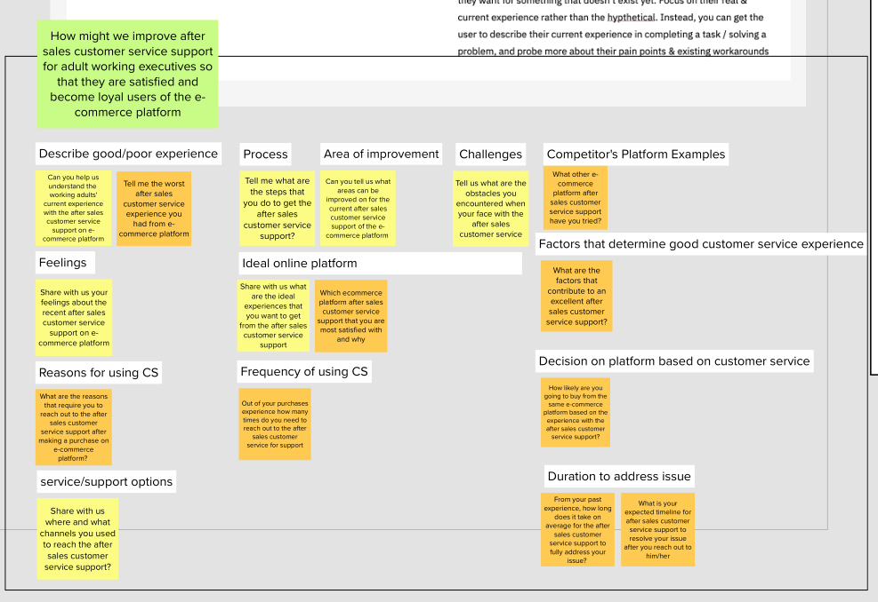
User Interview

Slide 4
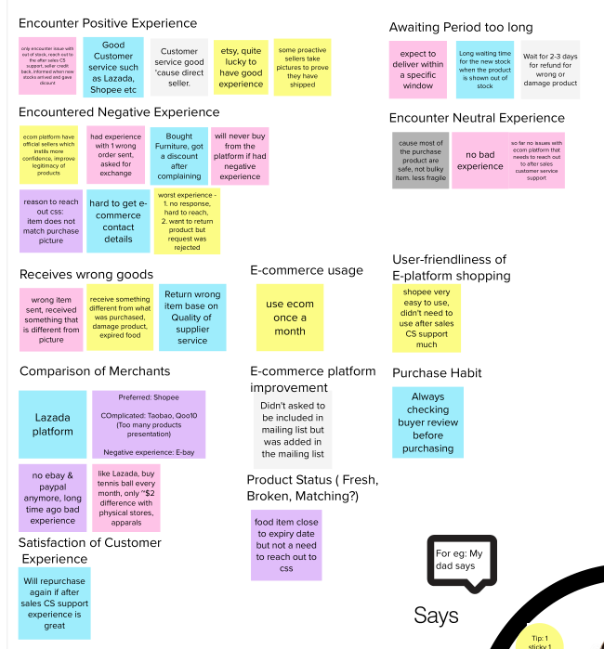
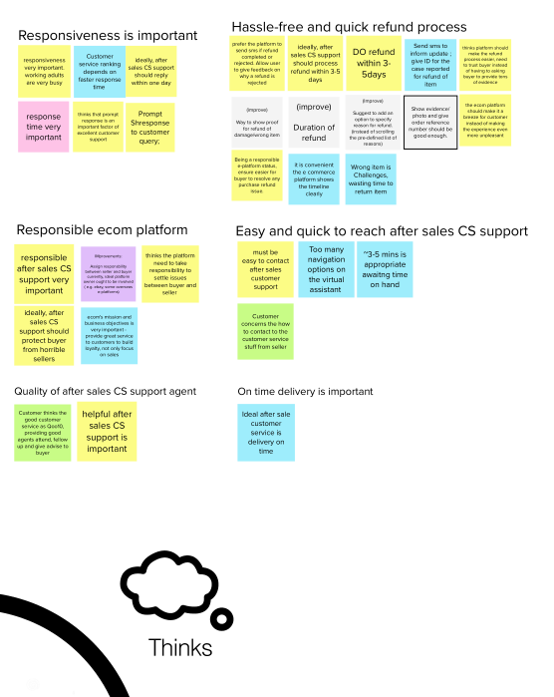
Empathy Map (P1)

Slide 5
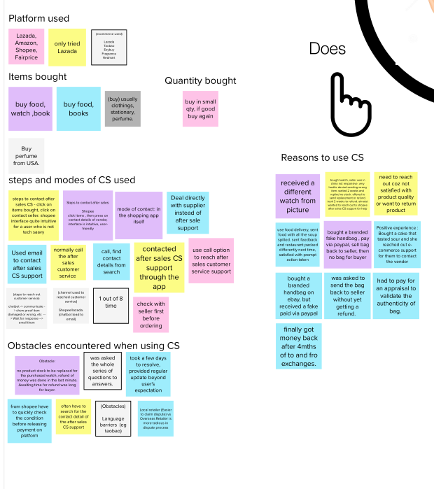
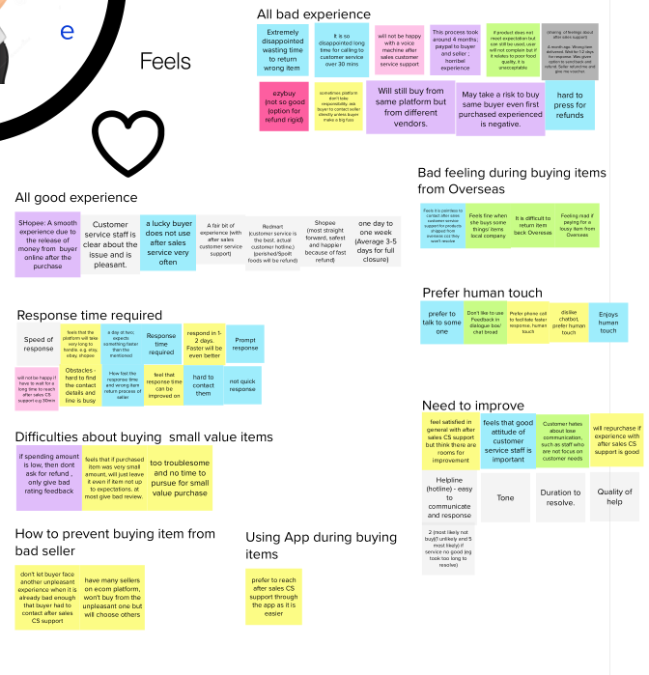
Empathy Map (P2)

Slide 6
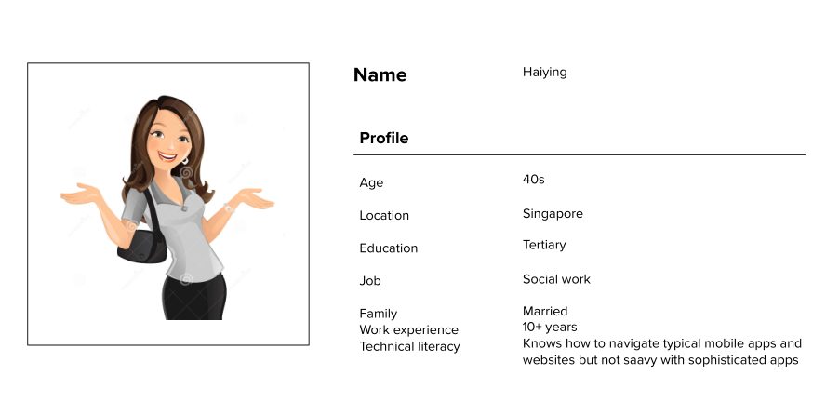
Persona

Slide 7
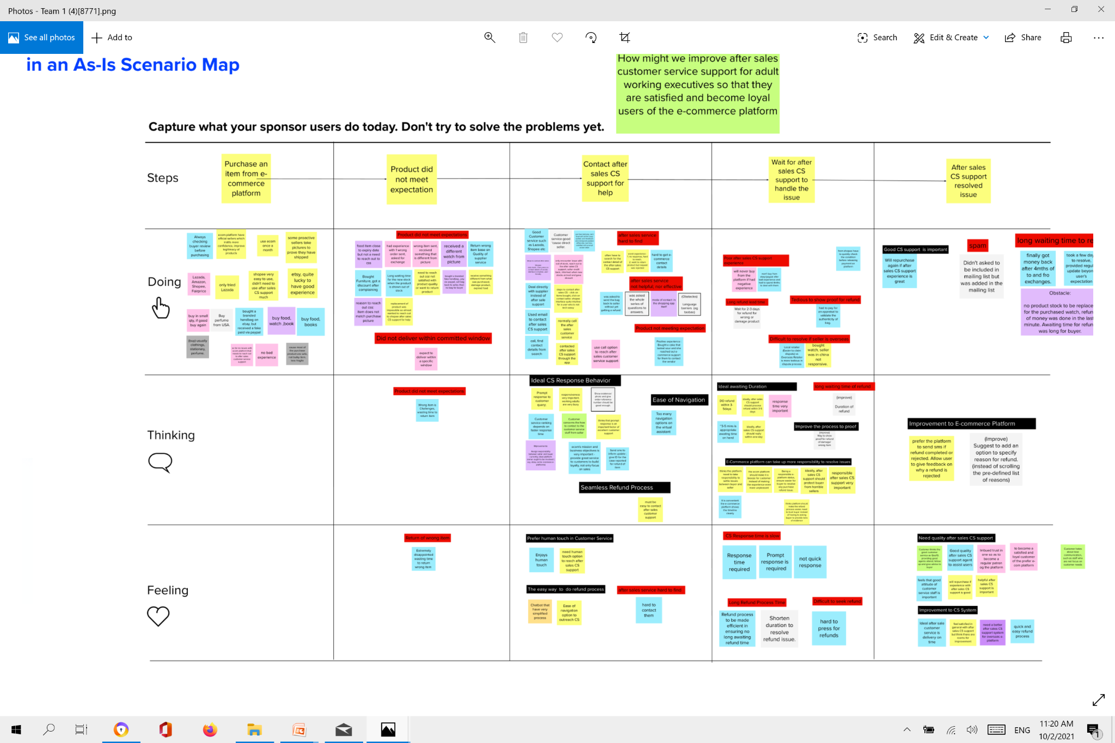
As-in Scenario Map
Long refund lead time
Spam
Did not deliver within committed window
After sales service hard to find
Tedious to show proof for refund
Good customer service support is important
After sales service not helpful nor effective
Difficult to resolve if seller is overseas
Product did not meet expectation
Long waiting time for refund
Customer service response time is slow
Return wrong item
After sales service hard to find
Need quality after sales support
Long refund process time
Difficult to see refund

Slide 8
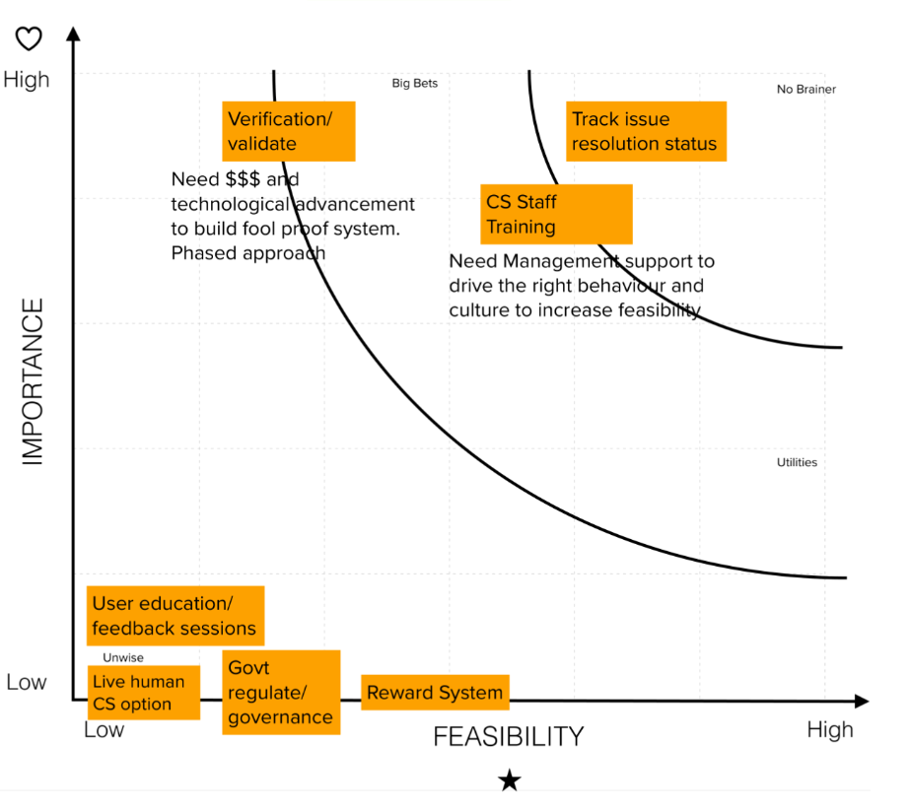
Prioritization Grid
Pain Points
Product did not meet expectations
Poor quality after sales customer service support
Long waiting time to resolve issue

Slide 9
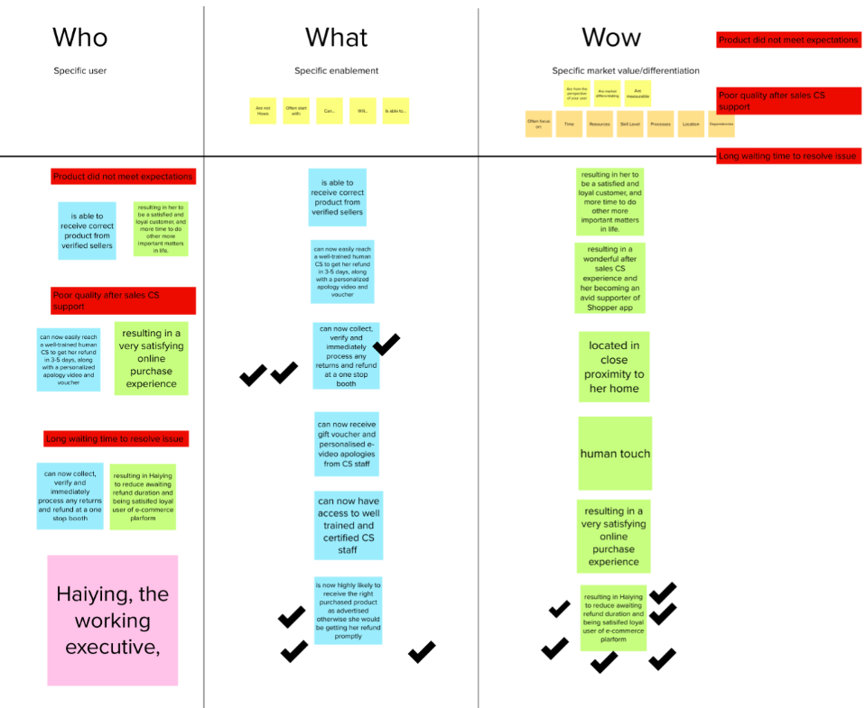
Hills

Slide 10
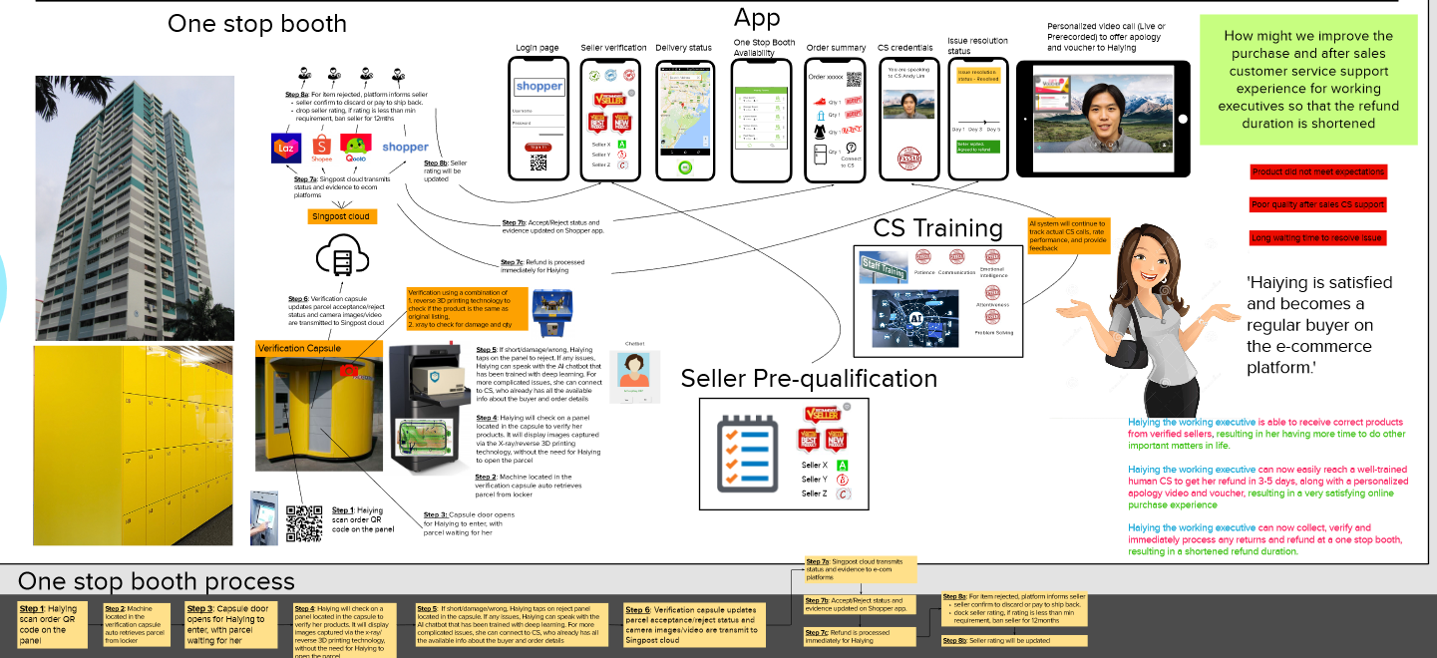
Prototype

Slide 11
Business Case
Our app have many participating companies that uses our refund services. Individual can choose any of our participating companies in our app and click on refund to do refund with them. As individuals choose to do refund with us, we give them incentives such as cashback. We hope to be able to scale our business from here.
Notes:
Our app have many participating companies that uses our refund services. Individual can choose any of our participating companies in our app and click on refund to do refund with them. As individuals choose to do refund with us, we give them incentives such as cashback. We hope to be able to scale our business from here.

Slide 12
Assumptions
Some businesses do not have the resources to do a seamless and fast refund, therefore requires our service.
It would be too costly for them to built their own.
We are able to get data from participating companies for analysis.
Participating companies got huge transaction data, so much so that they have 1000 complains in a month.
Assumes we have an agreement with participating companies that once we approved refund, they will send the money to the user.
Risk
Web attack on payment
New order details not updated at client’s DB for us to process refund effectively
Participating company does not release funds timely to the user

Slide 13
Hypothesis Statement
If we provide shoppers with fast refund*, we will observe:
1. Less complaint. Of the 1000 complaints, 90% and above were refunded within 5 mins.
*5 mins instead of current 7 days.
2. Higher user retention. Of the 1000 customers who did refund on our app, we will have data from participating companies to see if the same 1000 customers, if they do refund again, do they still use our app. (90% of the 1000 continues to use our app)

Slide 14
Final MVP Statement
If we provide shoppers with fast refund*, we will address the risk of unhappy shoppers by measuring the number of complaints and numbers of users retained. We’ll know we’ve arrived when we observed:
1. Less complaint. Of the 1000 complaints, 90% and above were refunded within 5 mins)
2. Higher user retention. Of the 1000 customers who we on-boarded onto our app, 90% have continued to use our app as a refund mechanism
*within 5 mins instead of current 7 days.

Slide 15
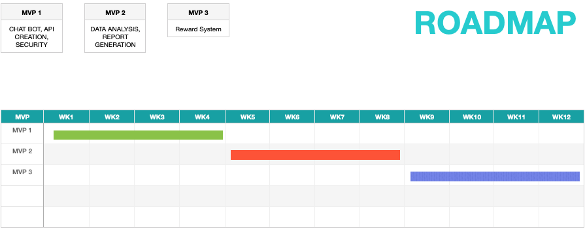

Slide 16
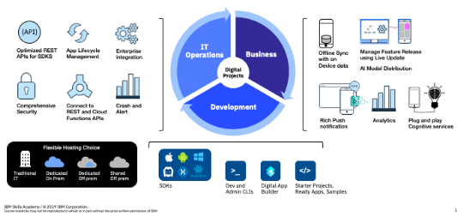
Multi Channel
Interact with clients in several ways
App
Website
Call center
Social Media
Notes:
Simply put, multi channel is a business strategy in which retailers interact with potential buyers in several different ways.
Demanding applications put strain on devices. A flexible cloud infrastructure can help with difficult workloads.
Organizations should fully integrate their mobile systems and data into other business processes to save time and cost.

Slide 17
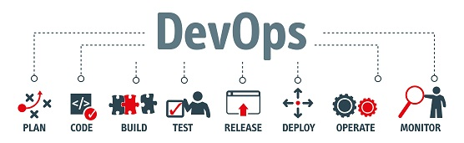
DevOps
Used AWS pipelines
AWS CodeCommit
AWS CodeBuild
AWS CodeDeploy
AWS CodePipeline
Notes:
DevOps is an enterprise capability for continuous software delivery and management that enables organizations to innovate rapidly to capitalize on new market opportunities, and reduce the cycle time to collect and react to customer feedback.
How it applies to our business case
Difference between devops/agile

Slide 18
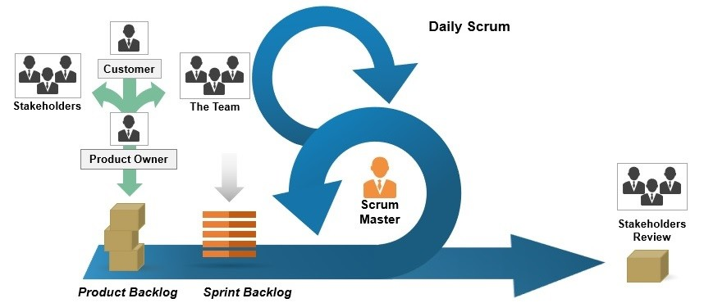
Agile (Scrum Methodology)
Individuals and interactions over processes and tools
Working software over comprehensive documentation
Customer collaboration over contract negotiation
Responding to change over following a plan
Notes:
Many Agile small teams to cater to each part of project, microservice

Slide 19
Type of system- PAAS
Platform as a Service
Removes the need for your organization to manage the underlying infrastructure (usually hardware and operating systems).
Allows you to focus on the deployment and management of your applications.
helps you be more efficient as you don’t need to worry about resource procurement, capacity planning, software maintenance, patching, or any of the other undifferentiated heavy lifting involved in running your application.

Slide 20
Hybrid Cloud
To connect infrastructure and applications between cloud-based resources and existing resources that are not located in the cloud.
The most common method of hybrid deployment is between the cloud and existing on-premises infrastructure.
To extend, and grow, an organization's infrastructure into the cloud while connecting cloud resources to the internal system.

Slide 21
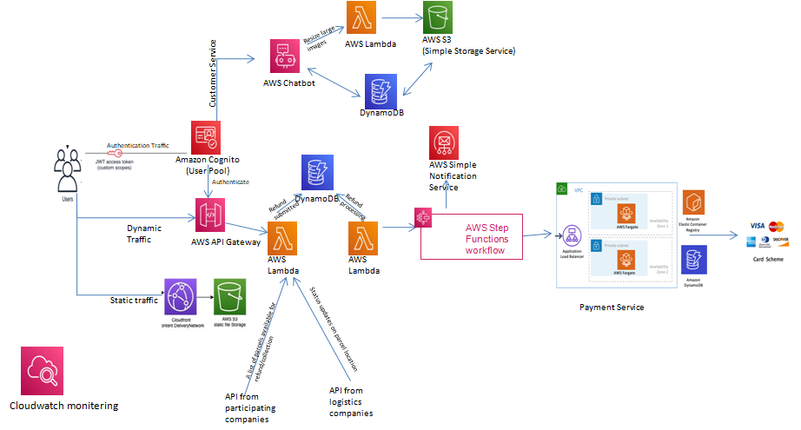




Cloud Architecture
Aws cloud
Notes:
This three-layer architecture can be set up in the AWS Cloud using serverless components:
Static content layer (Amazon CloudFront and Amazon Simple Storage Service (Amazon S3)). This layer stores static assets on Amazon S3. By using CloudFront in front of the S3 storage cache, we deliver assets to customers with low latency and high transfer speeds.
Authentication layer (Amazon Cognito). With Amazon Cognito, we can manage users’ sign-up, sign-in, and access controls, so this layer ensures that only authenticated users have access to secure data.
Dynamic content layer (AWS Lambda and Amazon DynamoDB). This layer contains all business logic required for our refund app and website. Our microservices are here as well. Using Lambda and DynamoDB ensures that these components are scalable and can handle peak traffic.
Payment (VPC)
Payment request is processed at application layer using Amazon Elastic Container Service that supports deploying tasks on AWS Fargate.
Payment transaction information is stored in Amazon DynamoDB.
Customer Service
We uses Amazon Lex, the chatbot with information stored on DynamoDB

Slide 22
Static Traffic - Cloudfront and aws s3
If you have a website, application, or another web resource, you probably have static content. Static content includes files like images, videos, or music.
AWS S3 Object Storage Service
When you put your content in an S3 bucket in the cloud, a lot of things become much easier. 1) Flexible and Scalable - You don’t need to plan for and allocate a specific amount of storage space because S3 buckets scale automatically.
2) Easy to use - Because S3 is a serverless service, you don’t need to manage or patch servers that store files yourself; you just put and get your content. Even if you require a server for your application (for example, because you have a dynamic application), the server can be smaller because it doesn’t have to handle requests for static content. 3) Readily available - It is designed to store and retrieve any number of files or objects from anywhere.
Notes:
Static content includes files like images, videos, or music. If you have a website or an app, you have static content. Our static Traffic comprises of 2 portions, S3 (Simple Storage Service) and Cloudfront. S3 stores the content and Cloudfront delivers it.
Advantage of using S3
1) Flexible and Scalable - Our applications can get to thousands of transactions per second in requesting to upload and retrieve contents like images from Amazon S3. With S3, we don’t have to worry about this as Amazon S3 automatically scales to high request rates. This also means that we don’t need to plan and allocate storage space.
2) Easy to use - Because S3 is a serverless service, we don’t need to patch servers that store files ourselves. Even if we need a server, the server can be smaller because it doesn’t have to handle requests for static content. 3) Readily available - S3 allows us to store and retrieve any number of files or objects from anywhere.

Slide 23
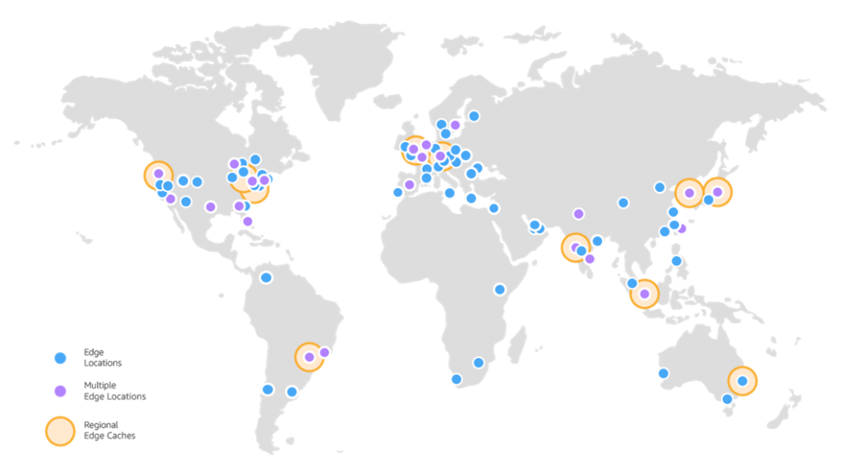
Cloudfront Delivers content on S3
Content delivery network - CloudFront is a content delivery network (CDN) service that delivers static and dynamic web content, video streams, and APIs around the world, securely and at scale.
Multiple servers worldwide - CloudFront serves content through a worldwide network of data centers called Edge Locations. Using edge servers to cache and serve content improves performance by providing content closer to where viewers are located. CloudFront has edge servers in locations all around the world, as you can see from the following map:
3) Inbuilt security function - By using CloudFront, we can set up additional access restrictions like geo-restrictions, signed URLs, and signed cookies, to further constrain access to the content following different criteria.
Notes:
Content delivery network and Multiple servers worldwide
As mentioned, Cloudfront delivers static content stored on S3. It has a worldwide network of data centers called Edge Locations. So Edge servers cache and delivers content faster as it provides content closer to where the viewers are located. The map on this slide shows the location of all the edge servers around the world.
CloudFront speeds up the distribution of our content by routing each user request through the AWS network to the edge location that can best serve our content to our users. And this server is usually the fastest delivery and nearer to the viewer. Using the AWS network dramatically reduces the number of networks that users' requests must pass through, which improves performance. Users get lower latency (time taken to load file)—and higher data transfer rates.
You also get increased reliability and availability because copies of your files are now held (or cached) in multiple edge locations around the world.
Inbuilt security function
Read from slide

Slide 24
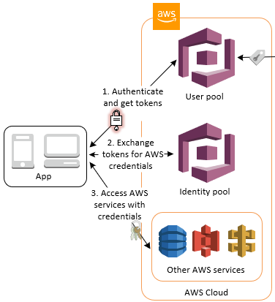
Authentication with Cognito
User pool + Identity pool - Two main components of Cognito User pool: User create and account ID and password with us. Identity pools: provide AWS credentials
Enable or disable unauthenticated identities - Amazon Cognito Identity Pools can support unauthenticated identities by providing a unique identifier and AWS credentials for users who do not authenticate with an identity provider. If your application allows users who do not log in, you can enable access for unauthenticated identities
Notes:
User pool + Identity pool
The two main components of Amazon Cognito are user pools and identity pools.
With the user pool, the user, logs in with his Id and password. Once this is verified, JWT is issued to him.
He can then exchange it for aws credentials at the identity pools to access other aws services that we have.
Enable or disable unauthenticated identities (unauthenticated people can see some content from our app/website as well, its going to be a very limited access)
Amazon Cognito Identity Pools can support unauthenticated identities by providing a unique identifier and AWS credentials for users who do not authenticate with an identity provider. This means for users who authenticate with us, they get access to more services such as payment. For users who do not authenticate, they will have limited access on our app/website. Eg, they might only be able to see who are our partnering companies, but are not able to go far beyond that.

Slide 25
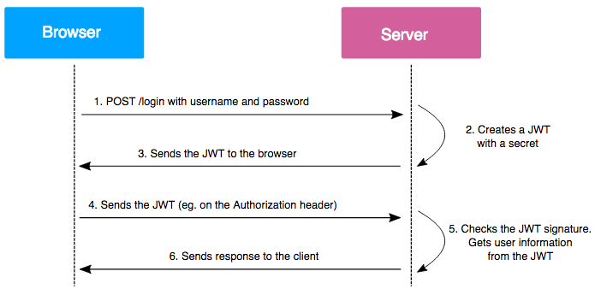
Credentials sent with Json Web Token
Notes:
How it works? 1) User sign-in using username and password 2) Authentication server which is AWS Cognito verifies it and issues an identity token in the form of jwt. This token is signed using a secret(or a private key.) The jwt issued here is a base64-encoded JSON string that contains information about the user or the so-called claims. 3) Then our user uses the JWT to access protected resources by passing the token in HTTP Authorization header. 4) Resource server then verifies the authenticity of the token using the secret. The ‘secret’ is in the signature. Lambda will be activated to use libraries to decode the token and verify the signature. This process is how we authenticate our users. When the ID Token is issued by Cognito, Refresh token is issued as well. ID token has an expiry which is written in the claims part at the payload section of JWT. (3 sections in JWT: header, payload, signature). Our users can use refresh token to retrieve new ID and access tokens, to browse our app/website continuously. Should the refresh token expires, our user must re-authenticate by signing in again to our user pool. JWT a client-side based authentication mechanism, we won’t have to completely rely on our own database to save session information.

Slide 26
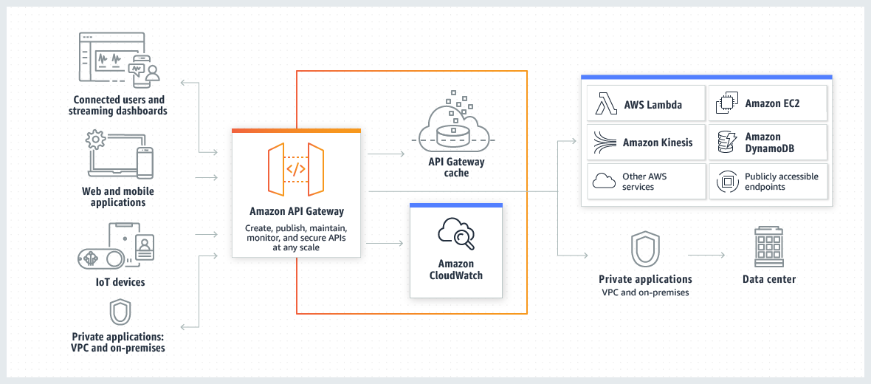
AWS API Gateway
Notes:
Amazon API Gateway is an AWS service for creating, publishing, maintaining, and monitoring APIs.
API Gateway handles all the tasks involved in accepting and processing up to hundreds of thousands of concurrent API calls. These tasks include traffic management, authorization and access control, monitoring, and API version management. Calls to our partnering companies’ api will go through this gateway as well.
API Gateway validates the JWTs that clients submit with API requests.
API Gateway acts as a "front door" for applications to access data, business logic, or functionality from our backend services ( such as workloads running on Amazon Elastic Compute Cloud (Amazon EC2) and code running on AWS Lambda)

Slide 27
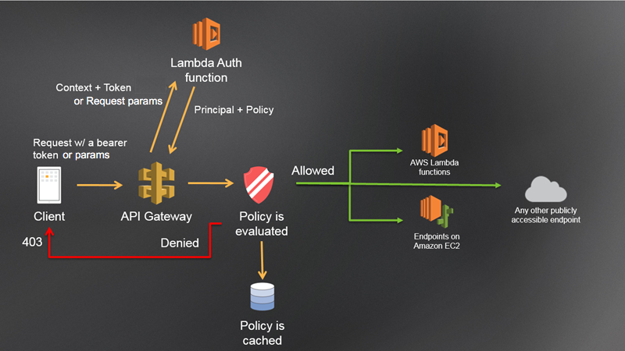
Control access to API
A Lambda authorizer is an API Gateway feature that uses a Lambda function to control access to your API.
Retrieving credentials from a database.
If the call succeeds, the Lambda function grants access by returning an output object containing at least an IAM policy and a principal identifier.
API Gateway evaluates the policy.
If access is denied, API Gateway returns a suitable HTTP status code, such as 403 ACCESS_DENIED.
If access is allowed, API Gateway executes the method.
The Lambda function authenticates the caller by means such as the following:
OAuth provider to get an OAuth access token.
SAML provider to get a SAML assertion.
IAM policy based on the request parameter values.
Notes:
In our API gateway, we have a Lambda authorizer to control access to our api.
The Lambda function authenticates the caller by:
Calling out to an OAuth provider to get an OAuth access token.
Calling out to a SAML provider to get a SAML assertion.
Generating an IAM policy based on the request parameter values.
Retrieving credentials from our database.
If the call succeeds, the Lambda function grants access by returning an output object containing at least an IAM policy and a principal identifier.
API Gateway evaluates the policy.
If access is denied, API Gateway returns a suitable HTTP status code, such as 403 ACCESS_DENIED.
If access is allowed, API Gateway executes the method and grants the client access to our resources such as our data about refund status. (If caching is enabled in the authorizer settings, API Gateway also caches the policy so that the Lambda authorizer function doesn't need to be invoked again.)

Slide 28
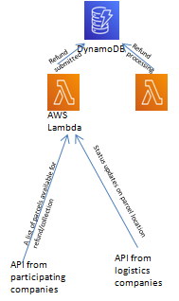
Microservices
Characteristics of Microservices
Autonomous
Specialized
Agility
Flexible scaling
Easy Deployment
Technological Freedom
Resilience
Notes:
Microservices are an architectural approach to our software development where our software is consists of many small independent services that communicate over well-defined APIs. Microservices architectures make applications easier to scale and faster to develop.
So why did we choose to have microservices? It is because of the following points on the slide.
Autonomous
Each component service in a microservices architecture can be operated without affecting other services. Specialized Each service is designed for a set of capabilities and focuses on solving one specific problem.
Agility
(Microservices are taken care by small, independent teams. These teams are specialised on the microservices they take care of and are empowered to work more independently and more quickly. This shortens development cycle times.
Flexible Scaling Microservices allow each service to be independently scaled to meet demand should there be a surge in demand. This enables us to right-size infrastructure needs, accurately measure the cost of a feature, and maintain availability if a service experiences a spike in demand.
Easy Deployment
Microservices enable continuous integration and continuous delivery, making it easy for our team to try out new ideas and to roll back if something doesn’t work. The low cost of failure makes it more possible to experiment new features, and makes it easier to update code.
Technological Freedom
Microservices architectures don’t follow a “one size fits all” approach. Teams have the freedom to choose the best tool to solve their specific problems.
Resilience
Service independence increases an application’s resistance to failure. In a monolithic architecture, if a single component fails, it can cause the entire application to fail. With microservices, when one microservice fails, only that one part of the app is not working, other parts of the app would still work
Reusable Code(Don’t Have this)
Dividing software into small, well-defined modules enables teams to use functions for multiple purposes. A service written for a certain function can be used as a building block for another feature. This allows an application to bootstrap off itself, as developers can create new capabilities without writing code from scratch.

Slide 29
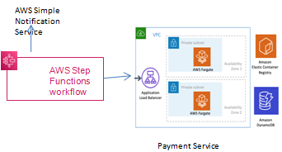
AWS steps function flow and Emailing service
Orchestrate microservices - Use Step Functions to combine multiple AWS Lambda functions into responsive serverless applications and microservices.
Notes:
After refund processing in done, we move to the AWS steps function flow. We use Step Functions to combine multiple AWS Lambda functions. After refund is approved, a lambda function is activated to send out email, followed by another lambda function activated to do refund to card/account and a lambda function to send out email once refund is completed.

Slide 30
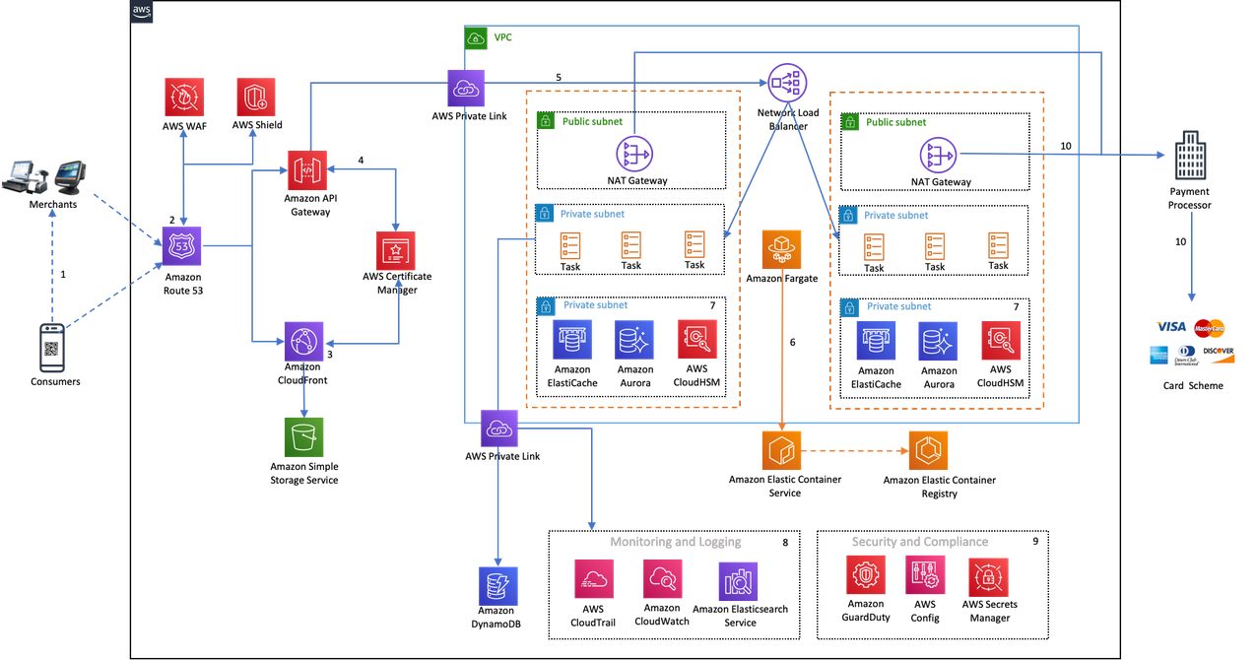
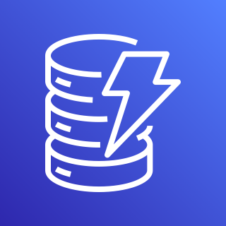
Payment service Part 1
The flow in vpc payment service
DynamoDB
DynamoDB
Notes:
Our payment part will be in a VPC for better security. The payment request is routed through a Network Load Balancer which can handle millions of request per second and distributes incoming traffic across its targets. Network Load Balancer is optimized to handle sudden and volatile traffic patterns while maintaining ultra-low latencies.
6. Then, Payment request is processed at application layer using Amazon Elastic Container Service that supports deploying tasks on AWS Fargate. With Fargate, we don’t have to provision, configure, or scale clusters of virtual machines to run containers. This removes the need to choose server types, decide when to scale your clusters, or optimize cluster packing.
In ECS, we run a tasks, which, in turns, run your container(s). A task contains (no pun intended) one or more containers.
7. Payment transaction information is stored in Amazon DynamoDB. Amazon ElastiCache is used as a session store to manage session information in the payment processing. We would also manage our encryption keys with CloudHSM for data protection.
10. Payment request is then sent to the payment processor via NAT Gateway that is in turn, connected to card schemes for verification.

Slide 31
Payment service part 2
Why VPC is needed?
Amazon virtual private cloud (VPC)
Sensitive data and information of our customers are required to store in our cloud database.
A virtual network dedicated to our AWS account, logically isolated from other virtual networks in the AWS Cloud.
Multiple layers of security, including security groups* and network access control lists (ACL) to protect AWS resources
Complete control over virtual networking environment, including resource placement, connectivity, and security.
We can define rules and policies for your services
Setting up subnets, IP ranges, and network configurations as required.
VPC endpoints enable us to privately connect your VPC to services hosted on AWS without requiring an Internet gateway, a NAT device, VPN, or firewall proxies.
Notes:
Instances is like applications

Slide 32
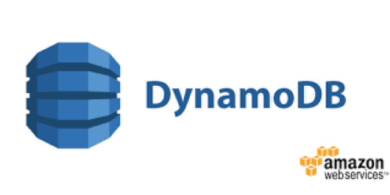
DynamoDB Feature | Benefit
Serverless | Fully managed, fault tolerance
Highly Available | 99.99% availability SLA
NoSQL type of database with Name/Value structure | Flexible schema, good for when data is not well structured or unpredictable.
Horizontal scaling | Seamless scalability to any scale with push button scaling or Auto Scaling
Transaction Options | Strongly consistent or Eventually consistent reads, support for ACID transactions
Backup | Point-in-time recovery down to the second in last 35 days; On demand backup and restore.
Notes:
fully managed NoSQL database service
automatically spreads the data and traffic for your tables over a sufficient number of servers to handle your throughput and storage requirements, while maintaining consistent and fast performance. (Highly available)
All of your data is stored on solid-state disks (SSDs) and is automatically replicated across multiple Availability Zones in an AWS Region, providing built-in high availability and data durability.
NoSQL - uses primary keys to uniquely identify each item in a table and secondary indexes to provide more querying flexibility.
In DynamoDB, there is no limit to the number of items you can store in a table.
Eventually Consistent Reads - When you read data from a DynamoDB table, the response might not reflect the results of a recently completed write operation. The response might include some stale data. If you repeat your read request after a short time, the response should return the latest data.
Strongly Consistent Reads - When you request a strongly consistent read, DynamoDB returns a response with the most up-to-date data, reflecting the updates from all prior write operations that were successful.
Backup - Point-in-time recovery helps protect your tables from accidental write or delete operations.
Provides on-demand backup capability. It allows you to create full backups of your tables for long-term retention and archival for regulatory compliance needs.

Slide 33
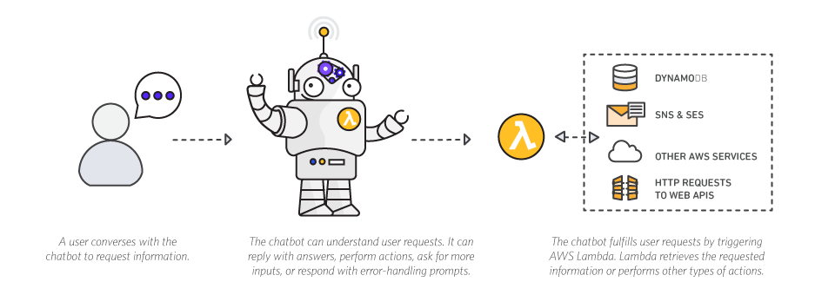
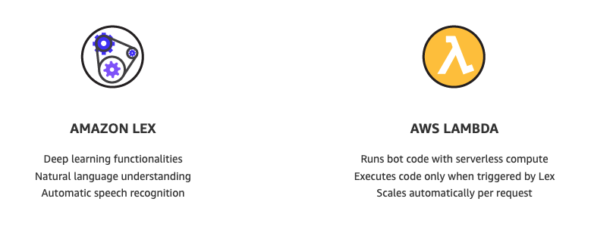
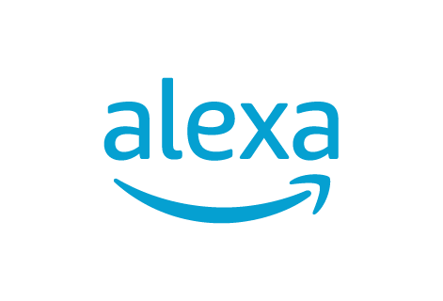
LEX Chat Bot
Notes:
Amazon Lex is a service for building conversational chatbot interfaces into any application using voice and text.
With Amazon Lex, you can build bots to increase contact center productivity, automate simple tasks, and drive operational efficiencies across the enterprise. As a fully managed service, Amazon Lex scales automatically, so you don’t need to worry about managing infrastructure.

Slide 34
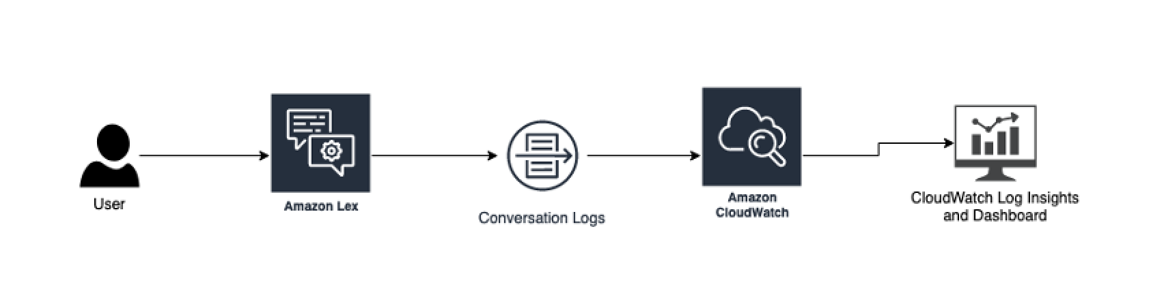
Data Analysis (Part 1)
LEX conversation logs
Notes:
Amazon Lex V2 is an AWS service for building conversational interfaces for applications using voice and text.
provides the deep functionality and flexibility of natural language understanding (NLU) and automatic speech recognition (ASR) so you can build highly engaging user experiences with lifelike, conversational interactions, and create new categories of products.
takes natural language speech and text input, understands the intent behind the input, and fulfills the user intent by invoking the appropriate business function.
enables any developer to build conversational bots quickly.
no deep learning expertise is necessary —to create a bot, you specify the basic conversation flow in the Amazon Lex V2 console.
It manages the dialog and dynamically adjusts the responses in the conversation.
Using the console, you can build, test, and publish your text or voice chatbot
Seamless Deployment - publish your voice or text bots for use on mobile devices, web apps, and chat services (e.g, Facebook Messenger).
Amazon CloudWatch monitors your Amazon Web Services (AWS) resources and the applications you run on AWS in real time.
You can use CloudWatch to collect and track metrics, which are variables you can measure for your resources and applications.

Slide 35
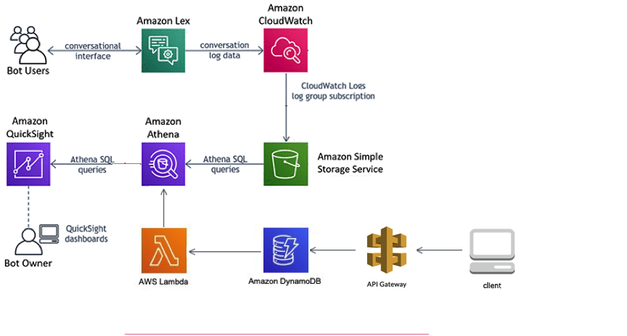
Data Analysis (Part 2)
Notes:
Amazon CloudWatch monitors your Amazon Web Services (AWS) resources and the applications you run on AWS in real time.
You can use CloudWatch to collect and track metrics, which are variables you can measure for your resources and applications.
Amazon Athena is an interactive query service that makes it easy to analyze data in Amazon database using standard SQL. Athena is serverless, so there is no infrastructure to manage.
Athena executes federated queries using Athena Data Source Connectors that run on AWS Lambda.
QuickSight - easily create and publish interactive BI dashboards

Slide 36
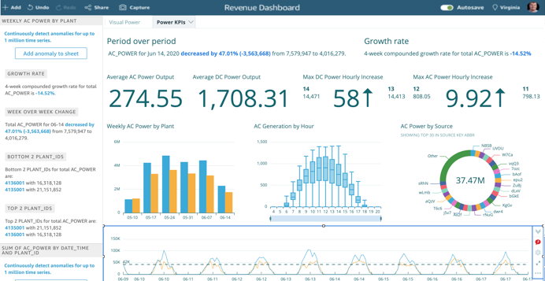
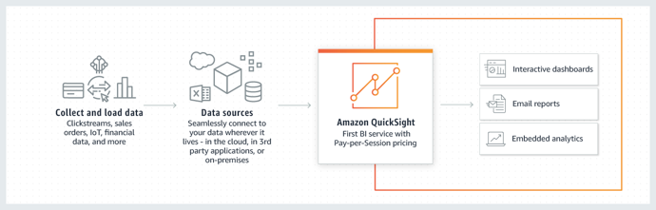
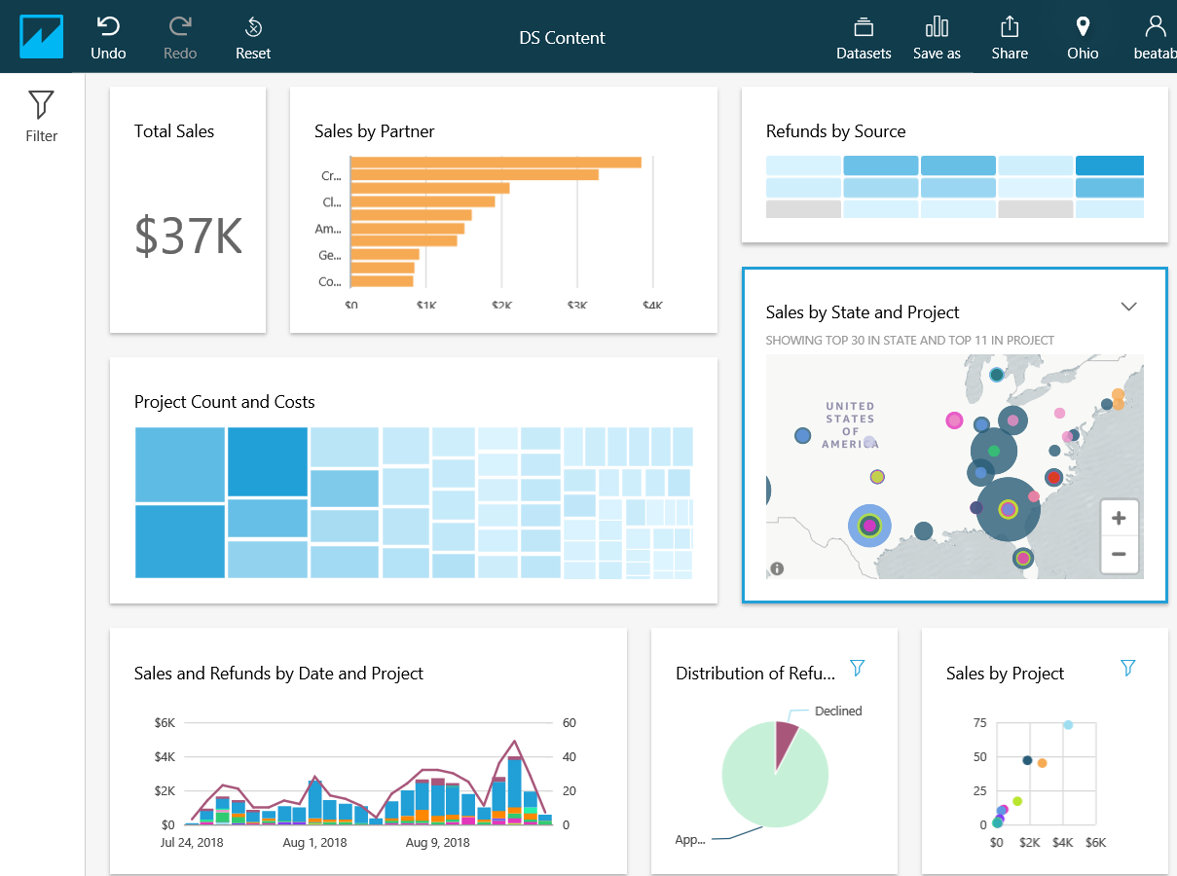
Data Analysis (Part 3)
Data to analyse (Client):
Item name
Frequency of refund
Reasons
Time frame
Notes:
QuickSight - easily create and publish interactive BI dashboards
receive answers in seconds through natural language queries.
QuickSight dashboards can be accessed from any device, and seamlessly embedded into your applications, portals, and websites.
QuickSight is serverless
automatically scale to tens of thousands of users.
Embedded Analytics - Seamlessly embed the ability to both view and author dashboards within your applications.
Pass to next speaker Beng Huat to talk about security

Slide 37
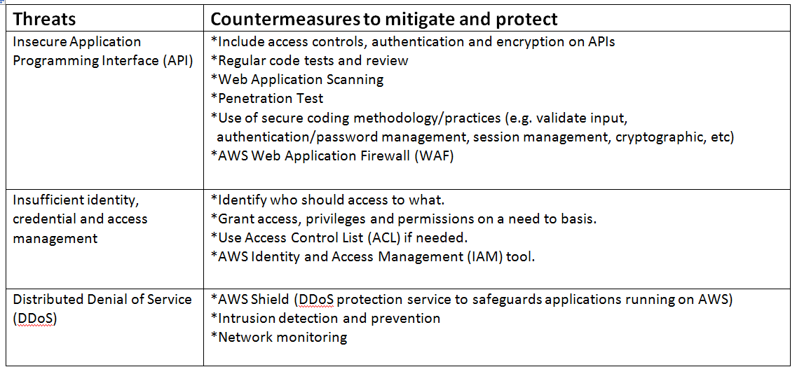
Security

Slide 38
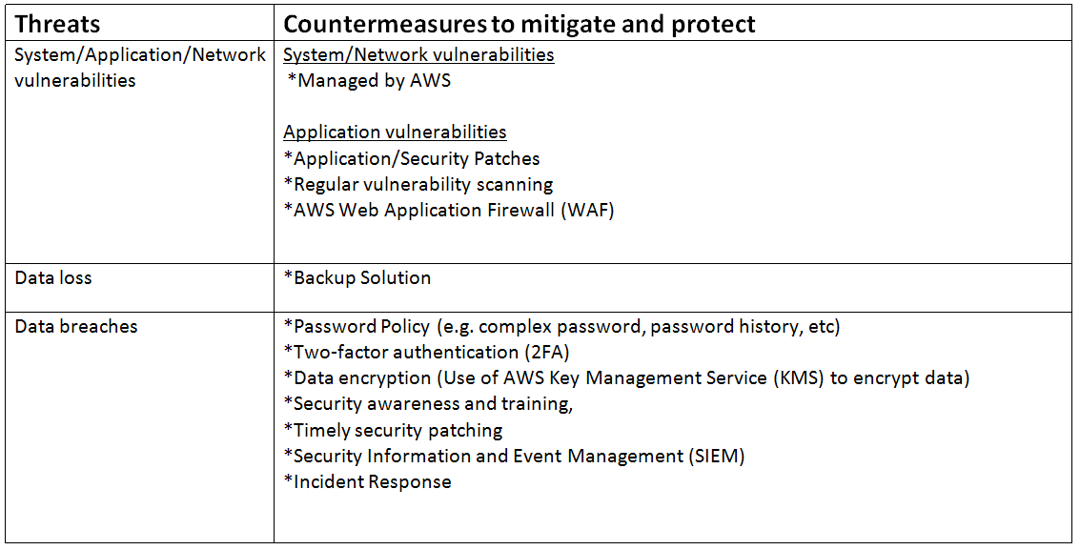
Security

Slide 39
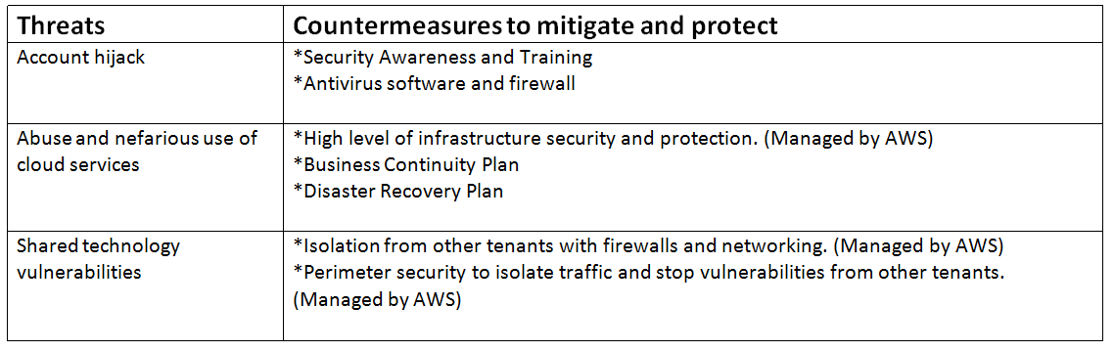
Security

Slide 40
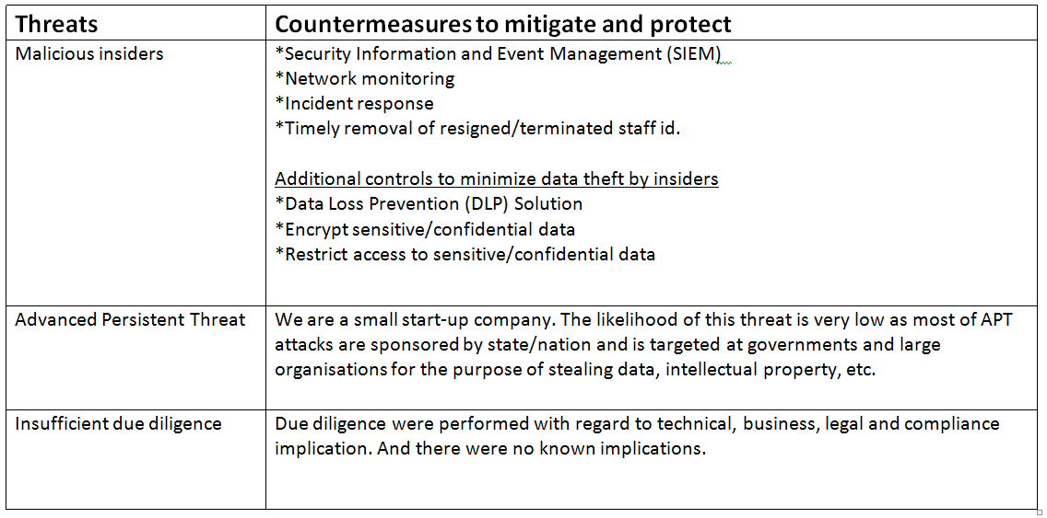
Security

